Slide 1
Accelerating DODGE BUBBLE using CUDA
CS6023: GPU programming course project (JAN-MAY 2020)
Sundar Raman P, EE17B069

Slide 2
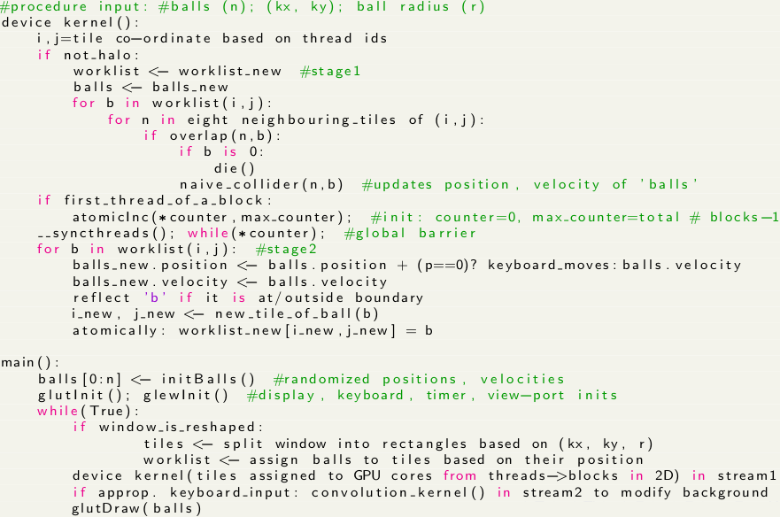
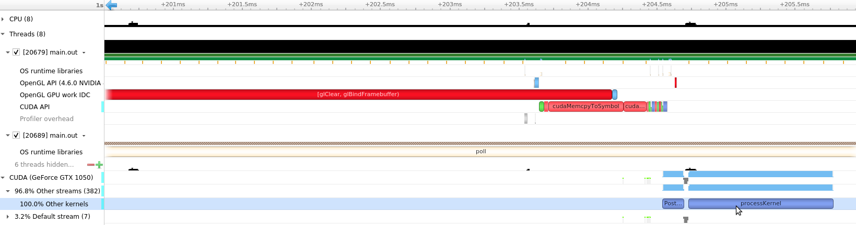
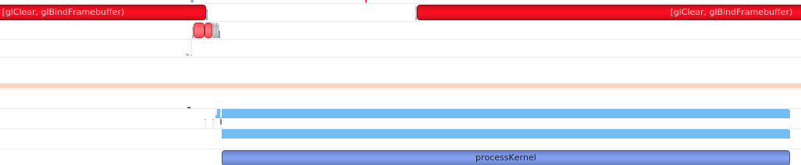
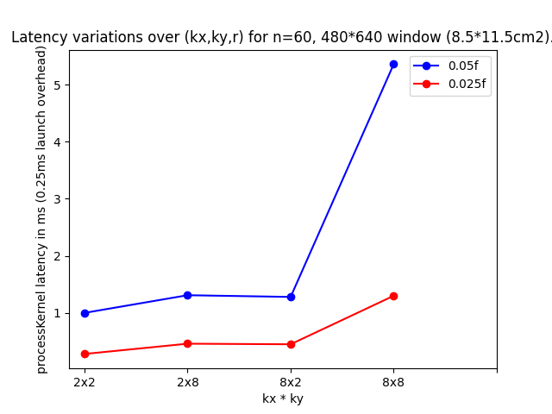
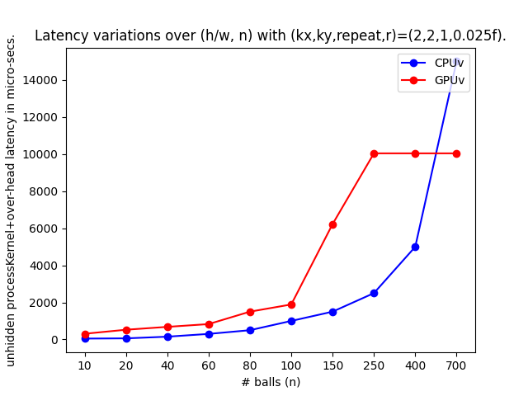
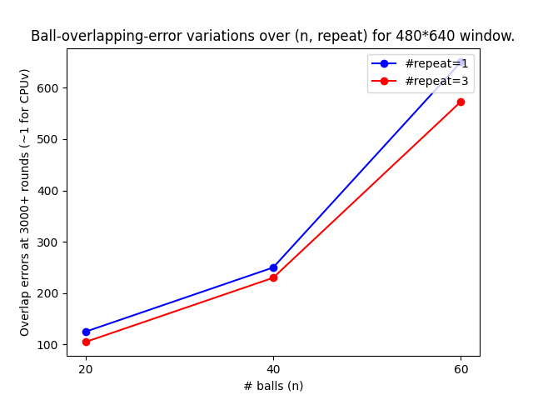
Problem Statement & Results:
Accelerate a 2D game where balls bounce into each other inside a window, using CUDA.
Key Idea: Split the window into square tiles, assign balls to tiles to perform path computations.
Latency hiding
Pseudo-code
Data

Slide 3
Challenges faced - Solution:
Parallelizing an inherently (exactly) ‘global’ problem - 2 approximate collision schemes!
Approximately non-overlapping displays - Old, new; 2 stages & a simple global barrier.
Passing ‘ball’ handling roles to neighbours - Update ‘worklist’ Atomically! (systolics)
Old ‘graphics.h’ library - OpenGL (glew, glut) with modern APIs, interops, h/w archs., etc.
Variety of background image data (RGBa) - Texture, depth binded to frame buffers
Circles in openGL - Circles using triangle fans
Dull background - Launch a (heavy) convolution kernel in a different stream
(Background) memory-access bottleneck - 2D Texture buffer
(Balls) memory-access bottleneck - Balls defined as Structure Of Arrays instead of AoS
Persistent kernel issue - Multiple kernel launches in a stream without cudaDeviceSync()
Lots of memory transfers between device, host - Pinned memory using cudaHostAlloc()
nvprof profiler - nsight visual profiler
Thread divergence due to conditionals - Ternary operator
Consistency of implementation - Track ‘energy’ variation over time (-0.00001/3000 rounds)
Get one ball to respond to user inputs - Keyboard handler
Naive game playing agents - Devised simple-rule based agents
Accessing common memory within a block - Profuse use of shared memory
Nested for-loop structure inside kernel - Cache-efficient structuring of them
Imp. ref.

